Slide 1

Predicting Probability of Heart Disease
Using Logistic Regression

Slide 2

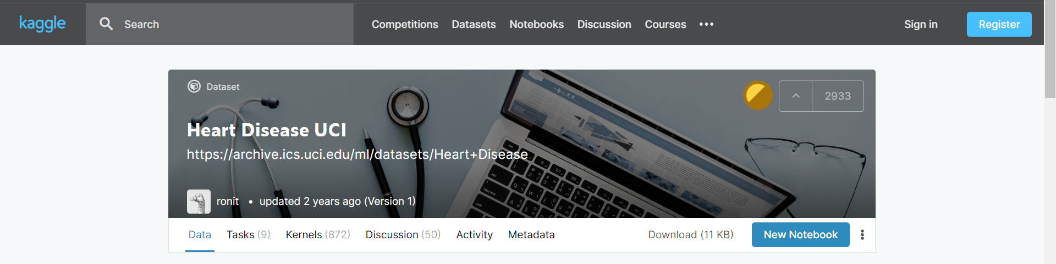
Dataset

Slide 3
Metadata
age - age in years
sex - sex (1 = male; 0 = female)
cp - chest pain type (1 = typical angina; 2 = atypical angina; 3 = non-anginal pain; 4 = asymptomatic)
trestbps - resting blood pressure (in mm Hg on admission to the hospital)
chol - serum cholestoral in mg/dl
fbs - fasting blood sugar > 120 mg/dl (1 = true; 0 = false)
restecg - resting electrocardiographic results (0 = normal; 1 = having ST-T; 2 = hypertrophy)
thalach - maximum heart rate achieved
exang - exercise induced angina (1 = yes; 0 = no)
ca - number of major vessels (0-3) colored by flourosopy
target - the predicted attribute - diagnosis of heart disease (angiographic disease status) (Value 0 = < 50% diameter narrowing; Value 1 = > 50% diameter narrowing)

Slide 4
Odds Ratio
Relation between probability and odds ratio
Let’s say that the probability of success is .8, thus
p = .8
Then the probability of failure is
q = 1 – p = .2
The odds of success are defined as
odds(success) = p/q = .8/.2 = 4

Slide 5
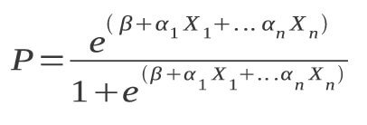
Logistic Regression
There is a direct relationship between the coefficients and the odds ratios
Logistic regression is in reality ordinary regression using the logit as the response variable,
log(p/q) = a + bX
Using the odds ratio we can get the predicted probability as follows

Slide 6
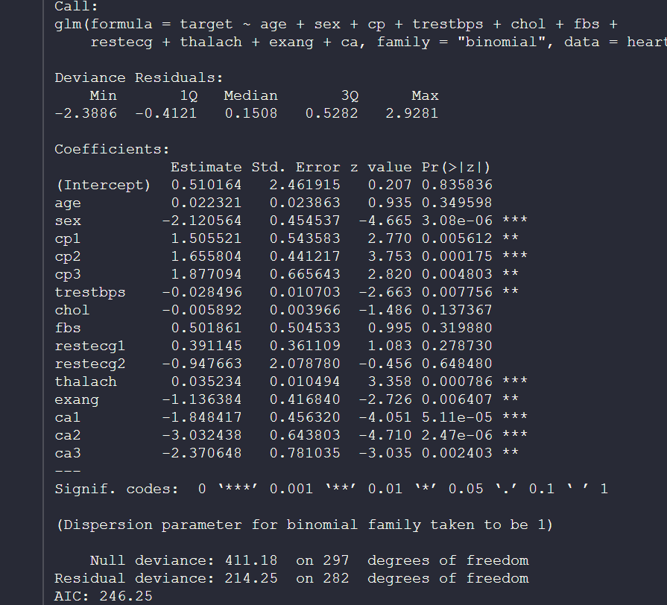
First Model

Slide 7
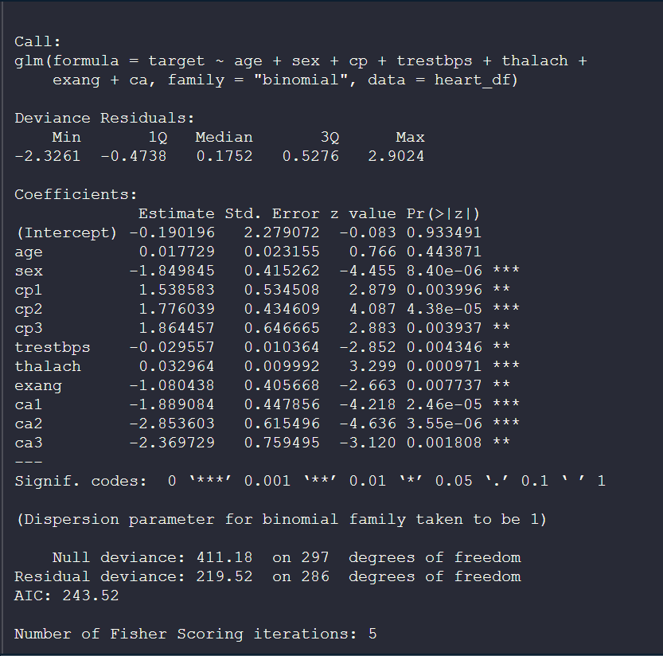
Final Model

Slide 8
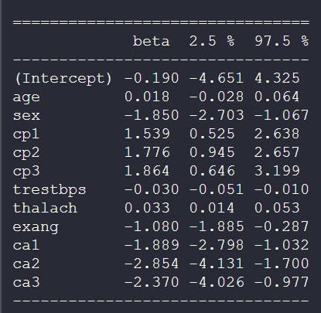
Coefficients and Conf Intervals

Slide 9
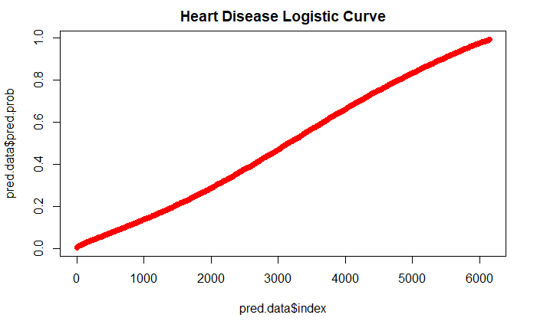
Plot of predicted probabilities based on different values of predictor variables

Slide 10
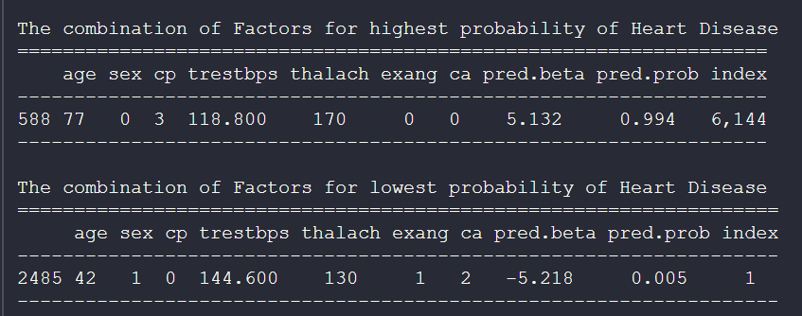
Combination of factors that produce highest and lowest probabilities of heart disease

Slide 11


